Slide 1
MIPS
Instruction Set Architecture
19CSE211 COA
Session 7
22-01-2021

Slide 2
Recap of Session 6
H.C. TD5102

Slide 3
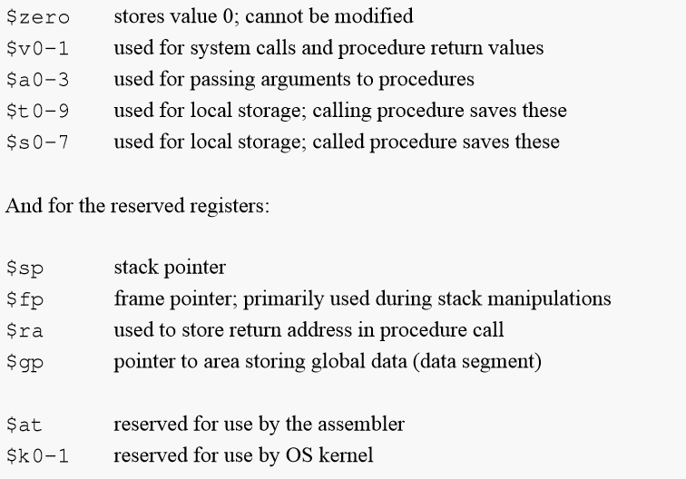
Used MIPS Conventions
32 Registers each of 32 bits
H.C. TD5102

Slide 4
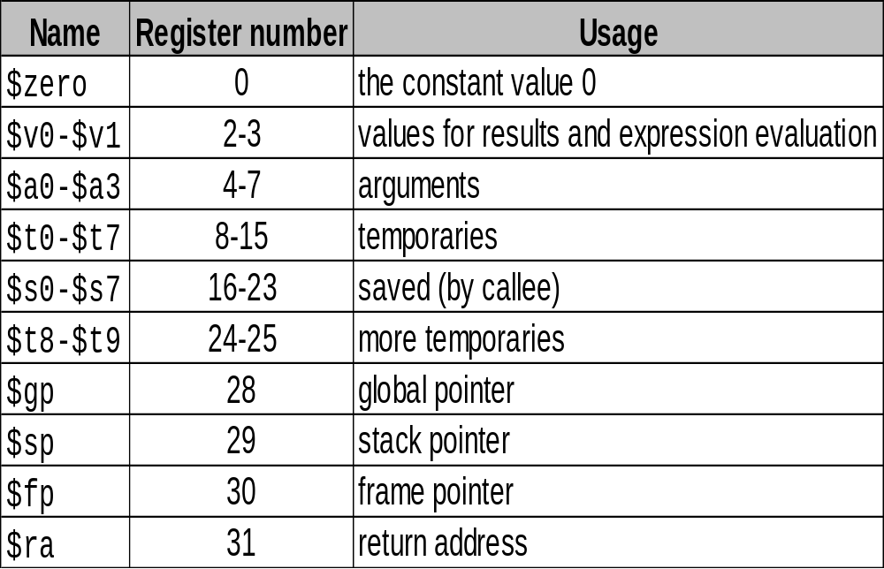
Used MIPS Conventions
$at – Reg No 1 – Reserved for Assembler
$k0, $k1 – Reserved for Operating System
H.C. TD5102

Slide 5
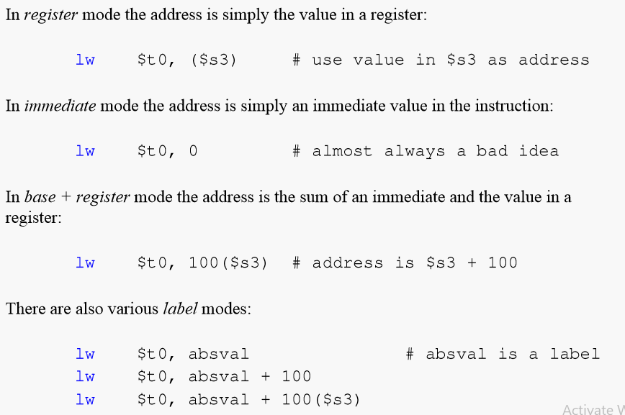
H.C. TD5102

Slide 6
MIPS ALP
H.C. TD5102

Slide 7
R Type Instructions
Main processor instructions that do not require a target address, immediate value, or branch displacement use an R-type coding format.
This format has fields for specifying of up to three registers and a shift amount.
For instructions that do not use all of these fields, the unused fields are coded with all 0 bits.
[00400030] 014b6020 add $12, $10, $11 ; 15: add $t4, $t2, $t3 # Add 000000 01010 01011 01100 00000 100000
0000 0001 0100 1011 0110 0000 0010 0000=> 0x014b6020
All R-type instructions use a 000000 opcode.
The operation is specified by the function field.
op 31-26 | rs 25-21 | rt 20-16 | rd 15-11 | sa 10-6 | fn 5-0
H.C. TD5102

Slide 8
Instruction |  | Function
add | rd, rs, rt | 100000
addu | rd, rs, rt | 100001
and | rd, rs, rt | 100100
break |  | 001101
div | rs, rt | 011010
divu | rs, rt | 011011
jalr | rd, rs | 001001
H.C. TD5102

Slide 9
I Type Instructions
I-type instructions have a 16-bit imm field that codes one of the following types of information.
• an immediate operand
• a branch target offset (the signed difference between the address of the following instruction and the target label, with the two low order bits dropped)
• a memory operand displacement
For the bgez, bgtz, blez, and bltz instructions,
the rt field is used as an extension of the opcode field.
op 31-26 | rs 25-21 | rt 20-16 | imm 15-0
H.C. TD5102

Slide 10
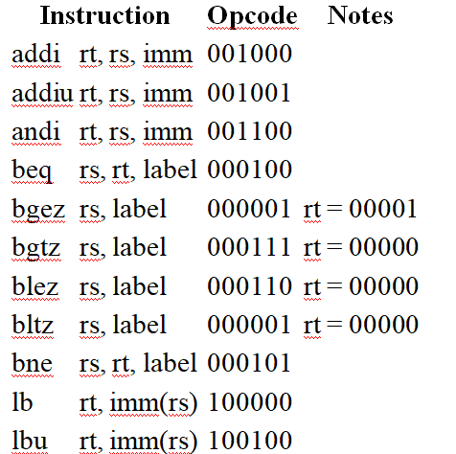
H.C. TD5102

Slide 11
J Type Instructions
The only J-type instructions are the jump instructions j and jal. These instructions require a 26-bit coded address field to specify the target of the jump.
When a J-type instruction is executed, a full 32-bit jump target address is formed by concatenating the high order four bits of the PC (the address of the instruction following the jump), the 26 bits of the target field, and two 0 bits.
op 31-26 | target 25-0
Instruction |  | Opcode | Target
j | label | 000010 | coded address of label
jal | label | 000011 | coded address of label
H.C. TD5102

Slide 12
Sample ALP using MIPS ISA
H.C. TD5102

Slide 13
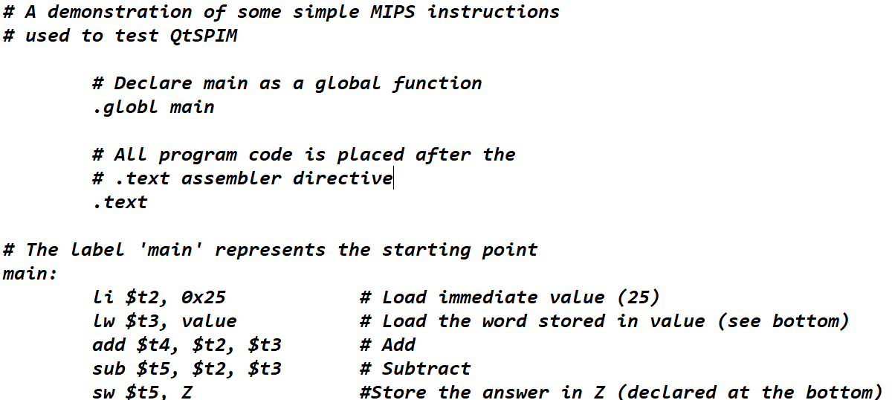
H.C. TD5102

Slide 14
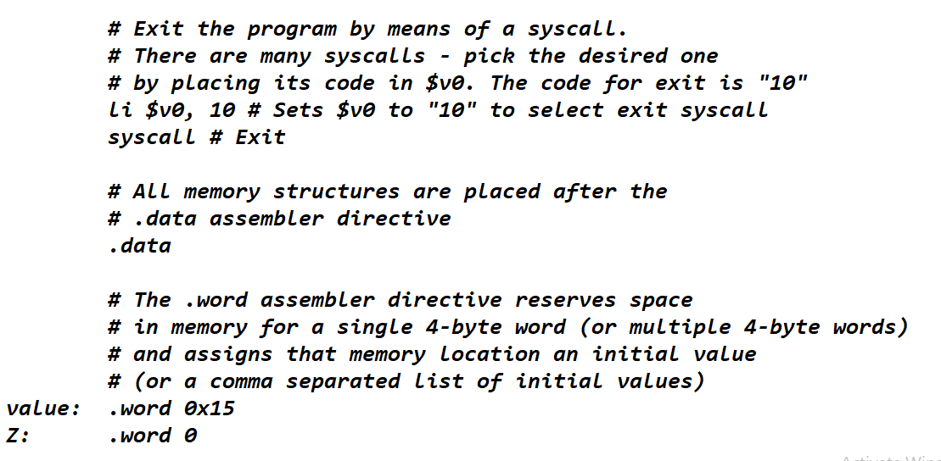
H.C. TD5102

Slide 15
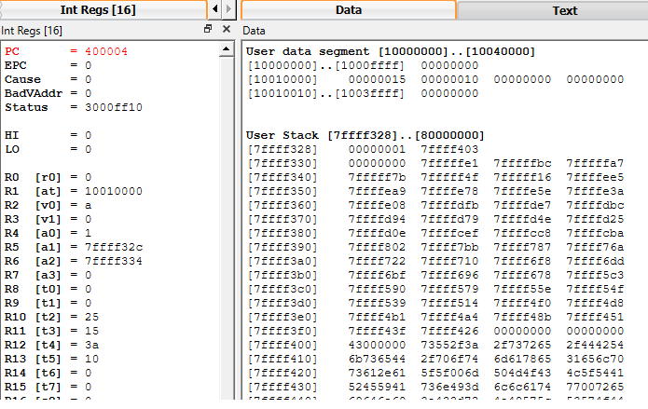
QtSPIM – Simulator for testing MIPS

Slide 16
MIPS
Instruction Set Architecture
Courtesy: Henk Corporaal
http://www.ics.ele.tue.nl/~heco/courses/EmbSystems
Technical University Eindhoven
DTI / NUS Singapore

